Slide 1
Cultural/Educational Exchange in Rival State
Chuing Chou
2015/11/26
Chiayi University

Slide 2
Dr. CHUING PRUDENCE CHOU
(周祝瑛)
Current Position :
Professor, Department of Education
National Cheng-Chi University, Taiwan
Ph.D. Comparative and International Education
(University of California, Los Angeles, USA, 1992)

Slide 3
Main theme:
How cultural and educational exchange affected the relationship between US and former USSR during 1950s–1980s.
To what extent does CEE impact other countries, such as Japan and the US, North and South Korea, Israel and Palestine, former West and East Germany, and China and Taiwan?

Slide 4
By demonstrating the dynamic relationship between the above-mentioned groups, the course will also compare educational systems among these countries and contrast the different outcomes of cultural exchange.
It will also introduce a new conceptual framework of cross-straitization using China and Taiwan as examples.

Slide 5
Selected readings:
Chapman, David W., Cummings, William K. & Postiglione, Gerard A. (eds.). (2010). Crossing Borders in East Asian Higher Education. Springer.
Chou, Chuing Prudence and Ching, Gregory S. (2012). Taiwan Education at the Crossroad: When Globalization Meets Localization. New York: Palgrave Macmillan.

Slide 6
Majhanovich, S. & Fox, C. (Eds.). (2009). Living Together: Education and Intercultural Dialogue. Singapore: Springer.
Shin, Gi-Wook, & Lee, Karin J. (eds.). (2011). U.S.-DPRK Educational Exchanges: Assessment and Future Strategy. Stanford, CA: The Walter H. Shorenstein Asia-Pacific Research Center.
Richmond, Yale. (2003). Cultural Exchange and the Cold War: Raising the Iron Curtain. University Park: Penn State University Press.
Online articles

Slide 7
In Yale Richmond’s
Cultural Exchange and the Cold War: Raising the Iron Curtain
The author concludes:
“cultural exchange has a gradual but compelling and long-lasting effect over transforming people’s attitude and mind-set, and therefore, it will change the relationship between rival parties and enemies.”

Slide 8
Themes
1. What do Globalization, Internationalization, Localization, and Cross-straitization Represent in the Higher Education of the 21st Century?
2. US and USSR: Cultural Exchange and the Cold War: How did Cultural and Educational Exchanges Raise the Iron Curtain?
3. How have Cultural and Educational Exchanges Shaped Japan through Outreach with Europe, America, China, and the World Since the 18th Century?

Slide 9
4. China and Taiwan: The Unprecedented Relationships Since 1987 and the Framework Formation of Cross-straitization
5. Two Koreas: How Can/Can’t Cultural and Educational Exchanges Make a Difference?
6. Two Germanys: The Unfinished Business after Unification
7. Israel and Palestine: Peace and Conflict in the Backyard
8. Islam and the World: Can Cultural and Educational Exchanges Alleviate Pain And Sorrow?

Slide 10
More than four million refugees of the Syrian Civil War have left the country during the course of the war. Most of them fled to neighboring Turkey, Lebanon, Jordan, and Iraq, while thousands also ended up in more distant countries of the Caucasus, the Persian Gulf, North Africa and Europe.

Slide 11
As of February 2015, Turkey has become the world's biggest refugee hosting country with 2.2 million Syrianrefugees and had spent more than US$7.6 billion on direct assistance to refugees.^{[2][93][94]}
The refugee crisis began in 2011, when thousands of Syrian citizens fled across the border to neighboring Turkey and Lebanon.

Slide 12
Why
No Respite? http://www.cna.com.tw/news/firstnews/201511255006-1.aspx

Slide 13
Pope Francis’ ‘Soft Power’ Diplomacy Aims to Bring Islam Into the Modern World 2014
Calls for the global search for solutions to radicalized Islam and religiously inspired terrorism.

Slide 14
the global search for solutions to radicalized Islam and religiously inspired terrorism.
the “peaceful coexistence and collaboration” and “climate of mutual respect” among different religious groups. This stands in stark contrast to what is taking place in Iraq and Syria right now.
He said, religion is being used as a “shield” to support “violence and repression.”

Slide 15
Words in contrast
War Peace
Hatred Love
Rivalry Collaboration
Competition ?
Conflict ?
Suspicion ?
Deception ?
Blockade ?

Slide 16
Why at wars?
Why is peace not attainable?

Slide 17
Definition of terms
Globalization
Internationalization
Localization
Glo-calization
Liberalization
Neo-liberalization
Cross-straitization
Educational exchange
Rival States

Slide 18
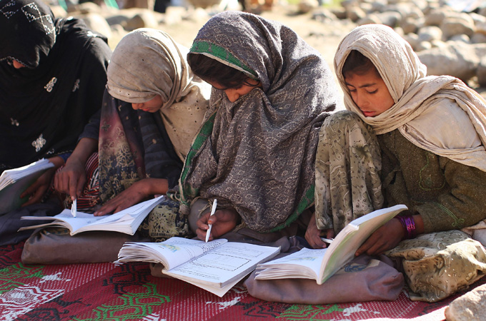
Can cultural and educational exchanges bring about the reconciliation of societies in conflict?
Anna Maria Napieralska

Slide 19
Study abroad programs and cultural exchanges are:
vital for gaining intercultural understanding and knowledge
commonly regarded as an important contribution to the achievement of culture of peace
Eisenhower:
„direct people-to-people exchanges are a one fine, progressive step toward peace in the world”

Slide 20

Qestions:
Do the educational exchanges have preventive value only or can also enhance the cooperation between nations in conflict?
Does the opportunity to get familiarize with values, outlooks and different perspectives can eventually bring together people whose governments are hostile towards each others?
Does the foreign study experience promote the tolerance of others and their opinions to the extent that in the long run can lead the reconciliation of feuding nations?

Slide 21
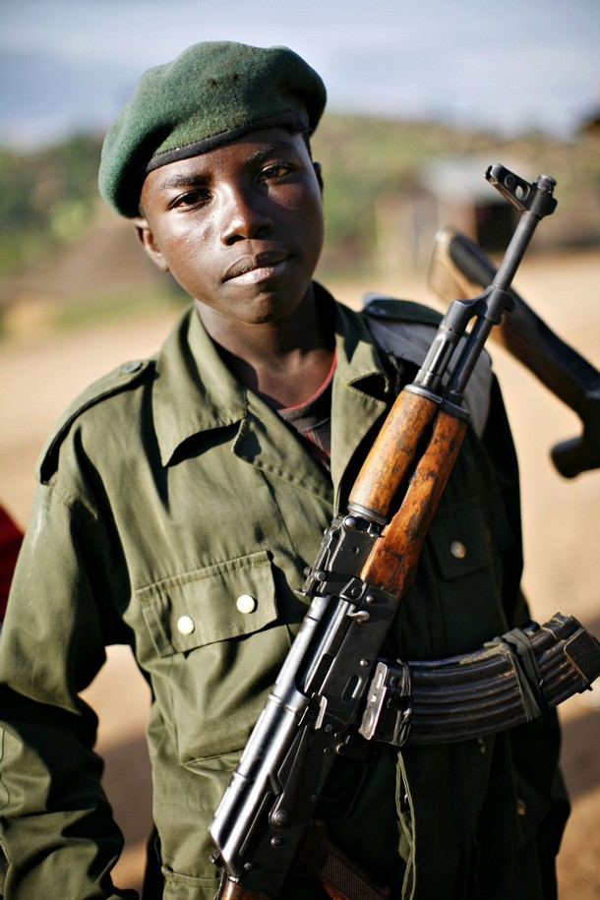
lasting impact of people-to-people exchanges depends on root of the conflict

Slide 22
Two types of values:
Political and Moral
American political values: freedom, democracy, liberty, tolerance or progress, technological and scientific skills and mindsets
American moral and cultural values: family relations, moral structure, religion
The new political mindsets can be engendered by study abroad experience, the moral values of Arab society (often claimed to be a source of the Western- Muslim conflict) remains unchanged or even strengthened.

Slide 23
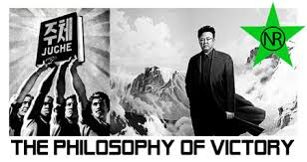
Koreal-U.S. cultural exchanges
communist ideology does not have such a strong hold on core values of Korean citizens as in case of Arab’s moral values in Western-Muslim conflicts, the break out of isolation and exposure to the different culture and mindsets can significantly weaken the hostility between nations

Slide 24
Educational cooperation between NK and U.S can:
contribute to the well-being of the citizens
provide means of communication outside of government channels
advance knowledge in varieties of fields
increase the empathy
long lasting effect on population leaving in the economic and political hardship of communist system
contribute to the peace between nations

Slide 25
How does the educational exchanges contribute to the peace building and facilitate Korea’s entry into more normal relations with Western nations?
Bridge-building (opportunity of the individuals to experience different society which, in turn, results in building ties, trust, and familiarity with the outside word )
Institutional linkages (cooperation between institutions that is fundamental for further improvements of the political and economic ties)
Trust - building

Slide 26
USSR and U.S. people-to-people exchanges
Gorbachev’s policy of pierestroyka and the final collapse of Iron Curtin was brought about by contacts and cultural and educational exchanges with the West
shaped Soviet elites in a key way and thus paved the path for the future changes of the Soviet system

Slide 27
Ideology
For the future communist establishment being and learning abroad was the moment to start challenging the strict communist ideology and to realize the consequences of the rigid and back warded regime
Igor Zevelev, Russian political scientist: ”Exchanges helped to overcome the ideology of dogma regarding communism and capitalism. We started to think differently, and saw the world as more complex then we had been taught to believe.”

Slide 28
Economy
the difference of the economical development between two countries and the backwardness of a regime saturated with ideology was impossible not to be acknowledged. Russians staying in the USA had got to see the rapid developments of scientific and technological discoveries which influenced directly the living standards of the regular American citizens. It made those Russians to recognize the need for change and reform in the Soviet system

Slide 29
Q & A
Thank you for your attention!

